Slide 1

PROJECT REVIEW ON DESIGN AND FABRICATION OF ROBOTIC ARM 3D PRINTER
J.CHANDU 18KD1A0328
K HEMANTH 19KD5A0314
G. SAI VAMSI 18KD1A0320
K. ANIL KUMAR 18KD1A0332
E.SAI JESWANTH 18KD1A0318
Under the esteemed guidance of
Mr. M. Daniel Silas Kumar
LENDI INSTITUTE OF ENGINEERING AND TECHNOLOGY
Department Of Mechanical Engineering
2018-2022

Slide 2
ABSTRACT
This Project is intended to integrate Robotics and 3D Printing technology to make efficient and cost effective printing as compared to current 3D printing technologies
One of the way is to equip a robotic arm with a material deposition head or extruder. 3D printing method is used in this project to fabricate the components of robotic arm.
Selective compliance assembly robotic arm(SCARA), this has four degrees of freedom and this makes printing stable. For an usual printer it is complicated to build a printed model beyond its printing bed range this limitation can be achieved by this printer by printing the model.
The printer is directly controlled by laptop or mobile so the design can be directly exported to printer whenever required after slicing, eliminating the use of storage devices. Fused Filament Fabrication is the additive method employed in this project. This technology allows for more precise and smooth printing of objects.
3D printing technology is used for printing the components of robotic arm. Movement of arm is obtained by stepper motor. And which is controlled by mother board.
And it is flexible for printing part and easy to portable.

Slide 3
INTRODUCTION
Robot 3D printing – also called robotic arm 3D printing and robotic additive manufacturing – combines a 3D printer head with a multi-axis robotic arm to create a much more flexible 3D printer than conventional three-axis (XYZ) machines.
3D PRINTING :
The technology printing physical 3D objects from digital data was developed by Chuck Hull in 1984 .He named the technique as stereo-lithography and obtained a patent for the technique in 1986.
3D Printing uses software that slices the 3D model into layers (0.01mm thick or less in most cases). Each layer is then traced onto the build plate by the printer, once the pattern is completed, the build plate is lowered and the next layer is added on top of the previous one.
3D Printing eliminates such waste since the material is placed in the location that it is needed only, the rest will be left out as empty space.

Slide 4
Robotics
Robots are defined as man made mechanical device whose motion must be models, planed, sensed, actuated and controlled. Whose motion behavior can be influence by programming.
Robots eliminate dangerous jobs for humans because they are capable of working in hazardous environments. They can handle lifting heavy loads, toxic substances and repetitive tasks
Different types of robots can performs different types of tasks. For example, many of the robots are made for assembly work which means that they are not relevant for any other work and these types of robots are called Assembly Robots.

Slide 5
LITERATURE REVIEW
S.No | Author Name(s) | Title | Year Of Publishing | Findings
01 | Rafal Siemasz, Ziemoeit Malecha | 3D Printing Robotic Arm With Elements Of Artificalintelligence | 2020 | Kinematic Of The Constructed Robotic Arm And Controling
02 | Ajay Anil, Raul Patail | 3D Printing Technology , Material Used For Printing And Its Appilcation | 2020 | Material Properties And Applications
03 | Lei Yu | 3d Spatial Printind | 2019 | Printed Polygon Mesh
04 05 | D.K.Shinde, D.N.Raut, Vinod.D Yao,lackner , Aburaia | 3d Ptintin G Aspects And Various Process Used In The 3d Printing Printing Of Object With Continuous Path By A Robotic Platform | 2017 2021 | Research On 3d Printing And Material Used In 3D Printing BIO BASED FIBERS USED IN ADDITIVE MANFACTURE

Slide 6
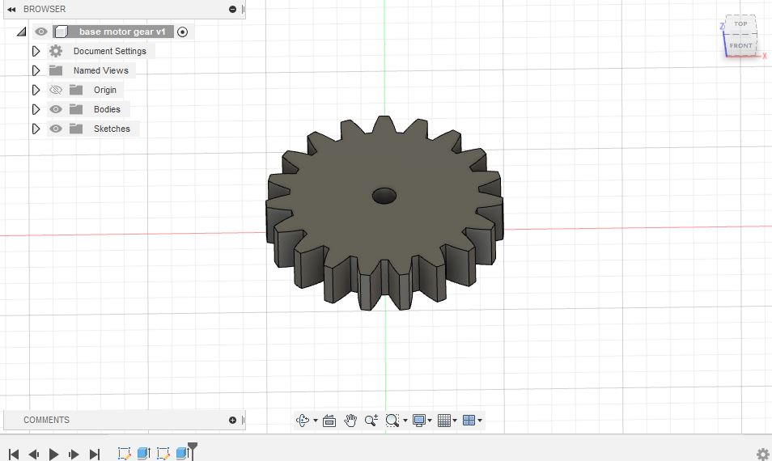
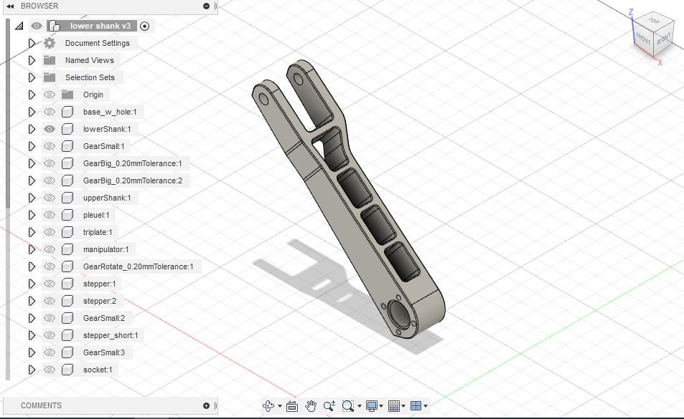
METHODOLOGY
DESIGNING : WE HAVE DEVELOPED THE DESIGN MODEL OF THE ROBOTIC ARM BY “AUTODESK FUSION 360” SOFTWARE.
GEAR
SHANK

Slide 7
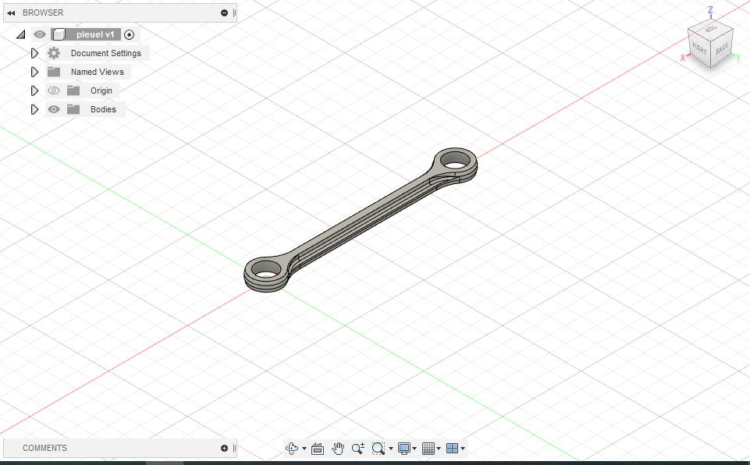
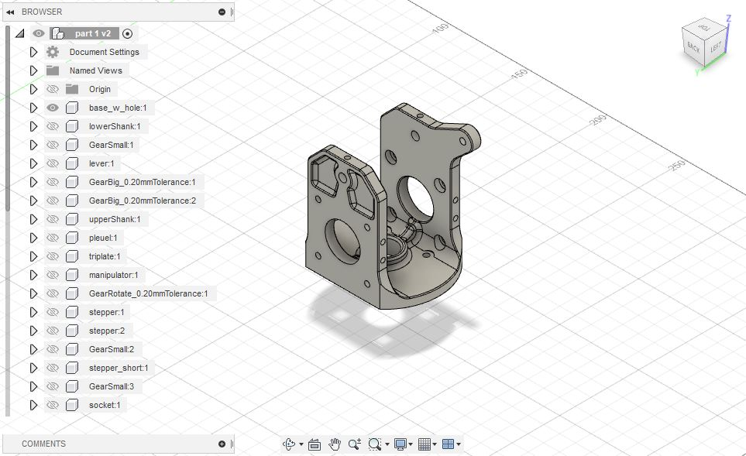
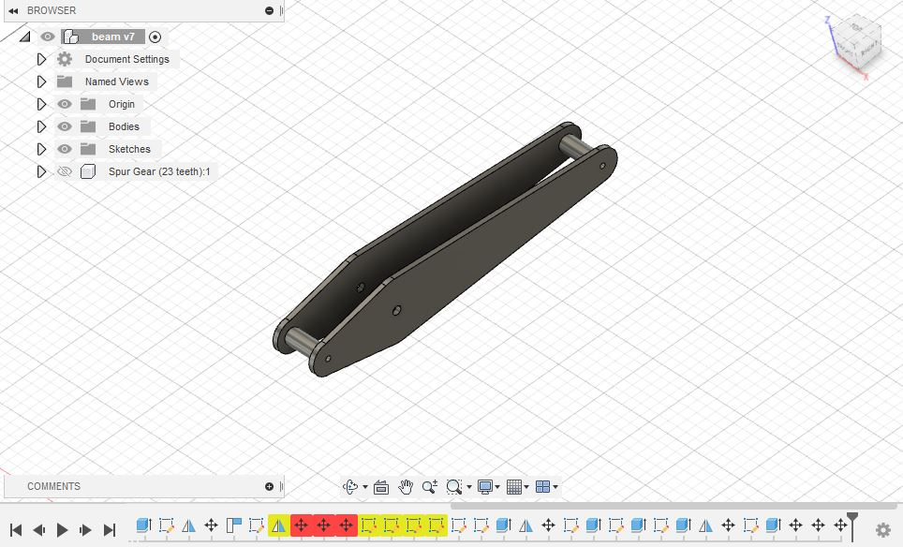
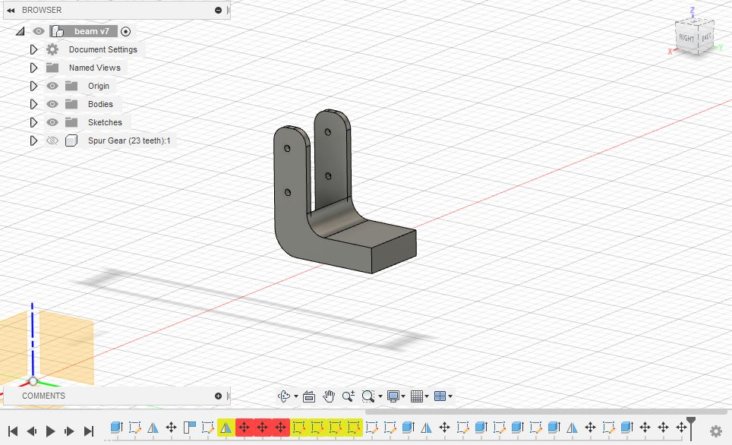
Puele
BASE
LEVER
HOLDER

Slide 8
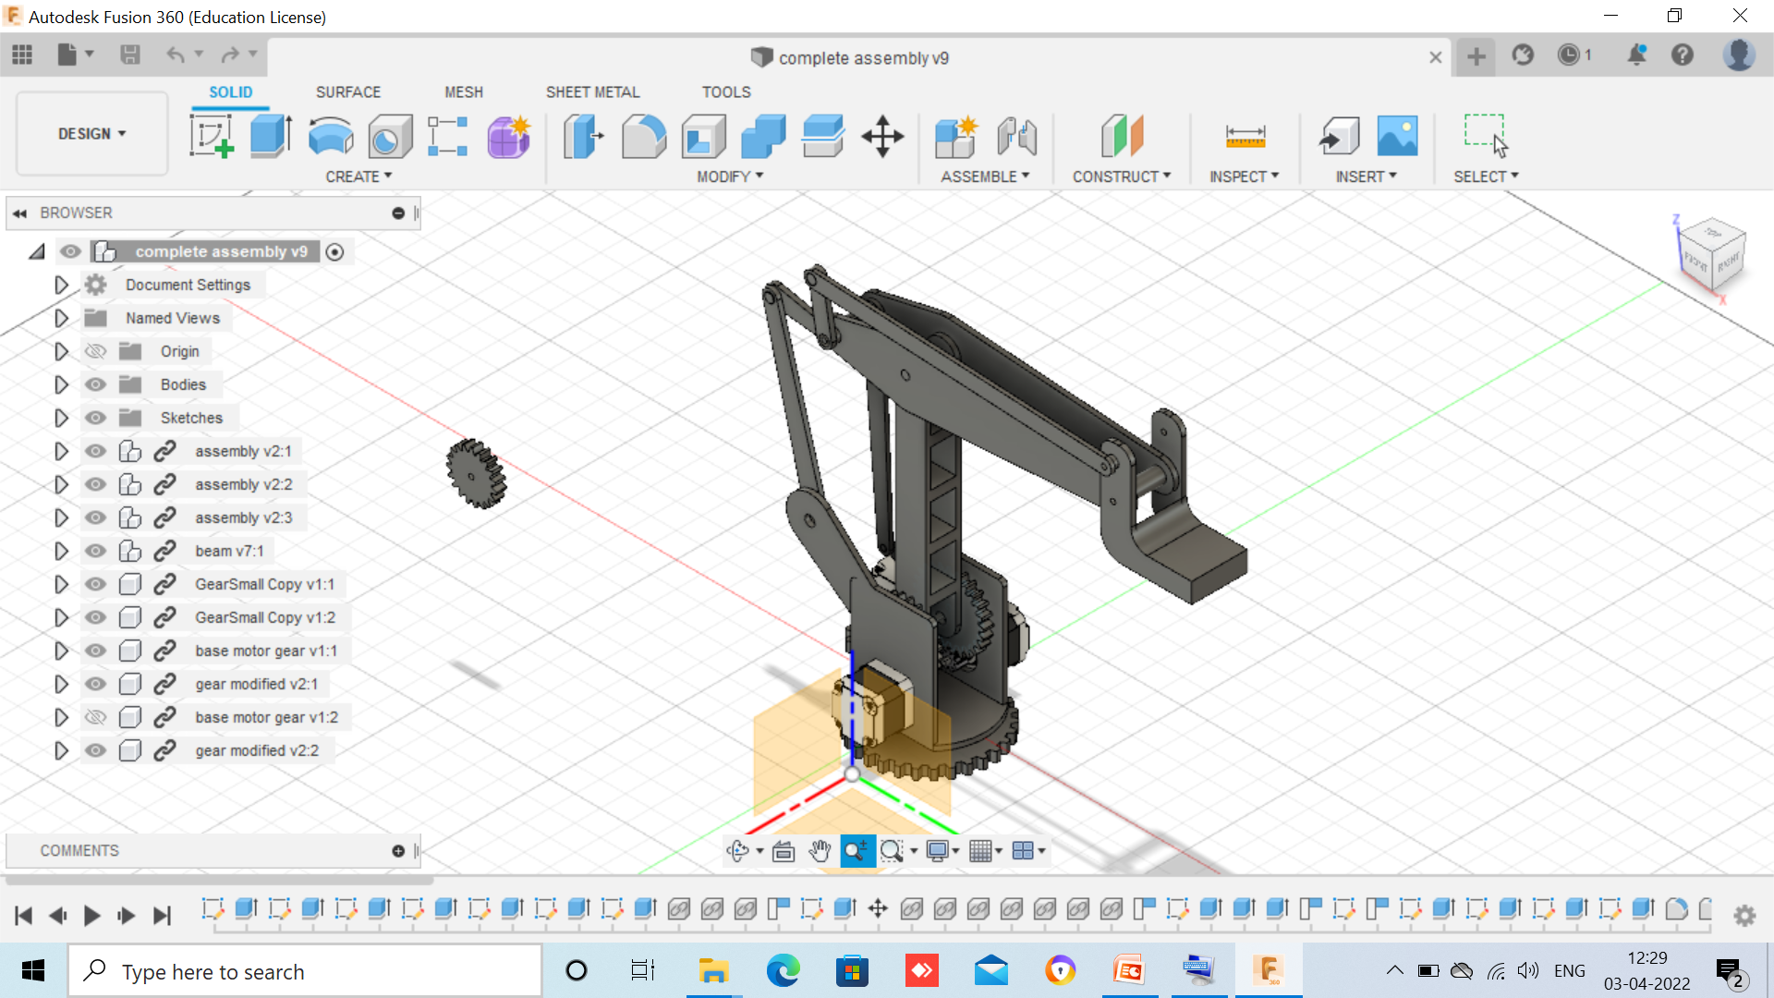
OVERALL ASSEMBLY OF DESIGN MODEL

Slide 9
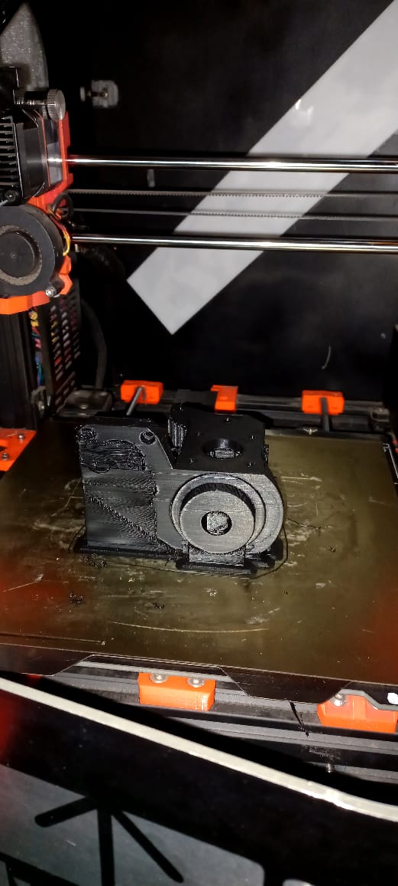
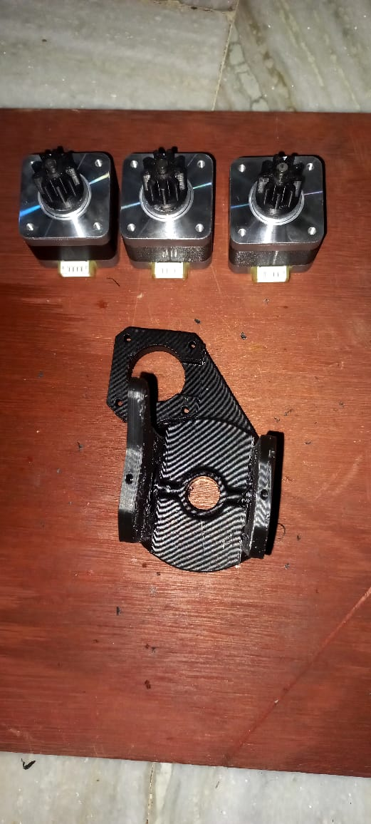
FABRICATION OF PARTS: THE PARTS WERE FABRICATED BY USING THE G-CODES WHICH ARE RUN IN ADRIANO PROCESSOR WHICH IS CONNECTED TO THE 3D PRINTER .
MATERIAL USED :ACRYLONITRILE BUTADIENE STYRENE(ABS)
G-CODE GENERATION: AND THEN “SLICING SOFTWARE” IS USED TO GENERATE G-CODE FOR THE DESIGN MODEL.

Slide 10
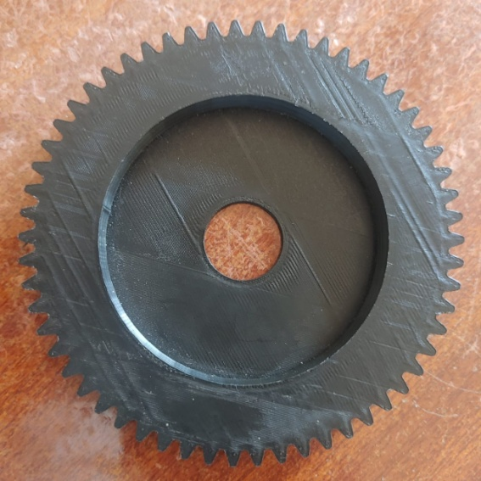
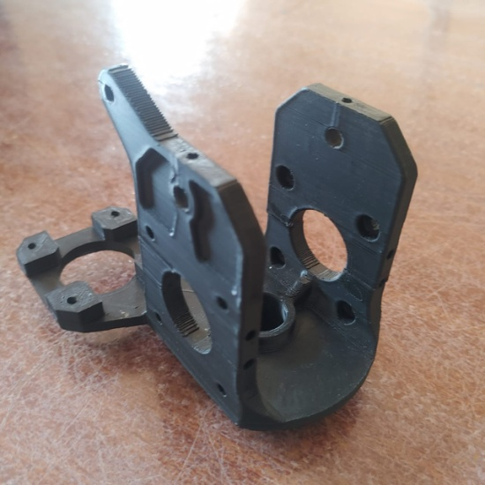
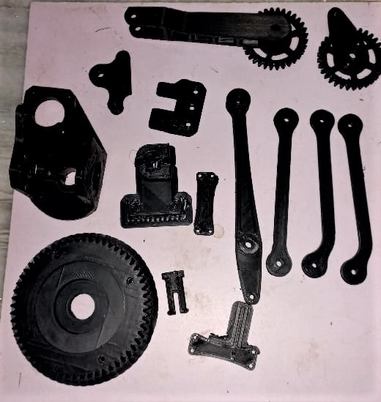
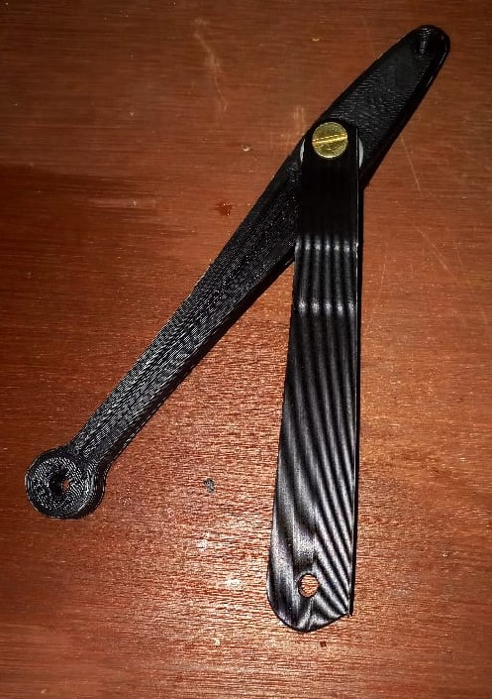
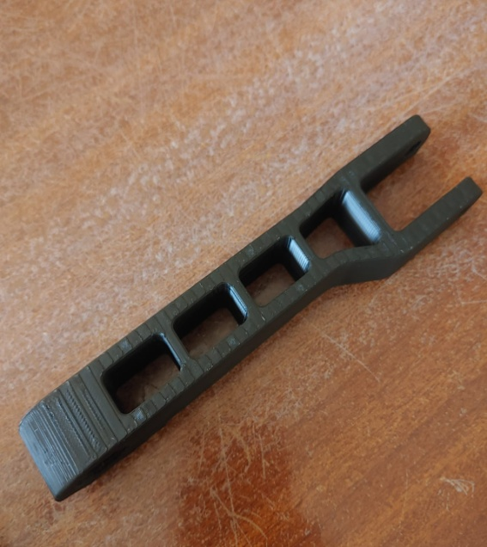
FABRICATED PARTS

Slide 11
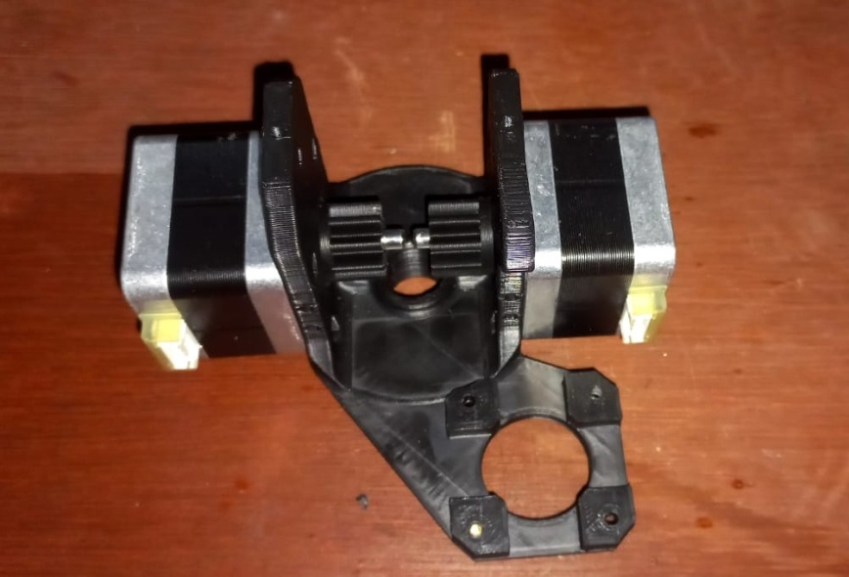
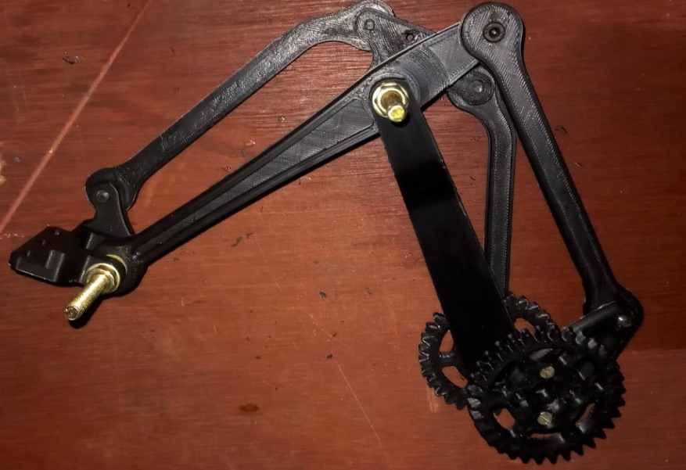
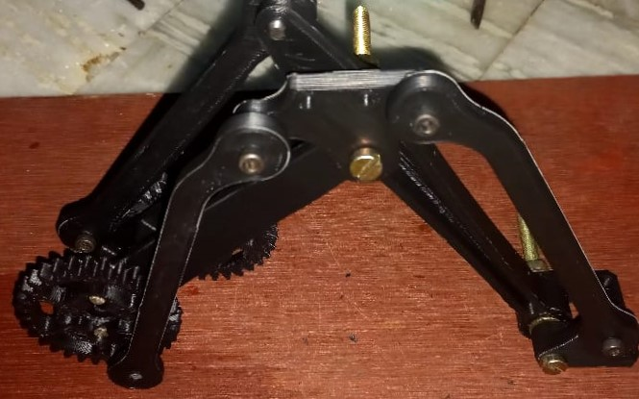
ASSEMBLY : ASSEMBLY OF ALL THE INDIVIDUAL 3D PRINTED PARTS INTO A ROBOTIC ARM USING THE NUTS AND BOLTS

Slide 12
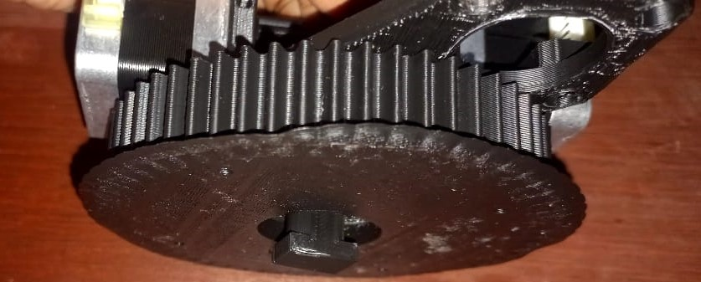
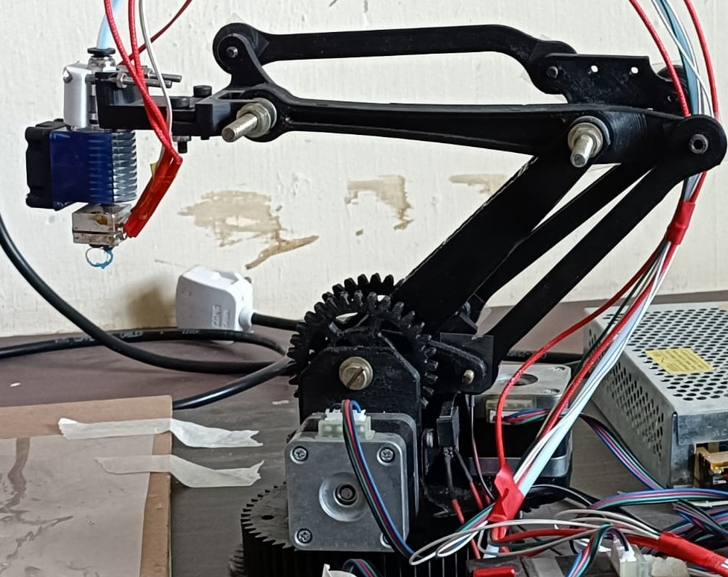
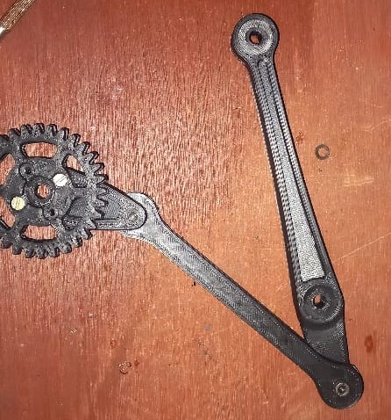

Slide 13


SOFTWARE USED: MARLIN 1.1X FORMWARE USED TO RUN AND CONTROL THE PRINTER, WHICH IS MODIFIED ACCORDING TO THE PRINTER, SPECIFICATIONS WE NEED , BY USING ARDUINO IDE SOFTWARE THE MARLIN CODE WILL RUN AND COMPILE AND IT IS DUMPED INTO THE CONTROL BOARD THROUGH USB CABLE

Slide 14
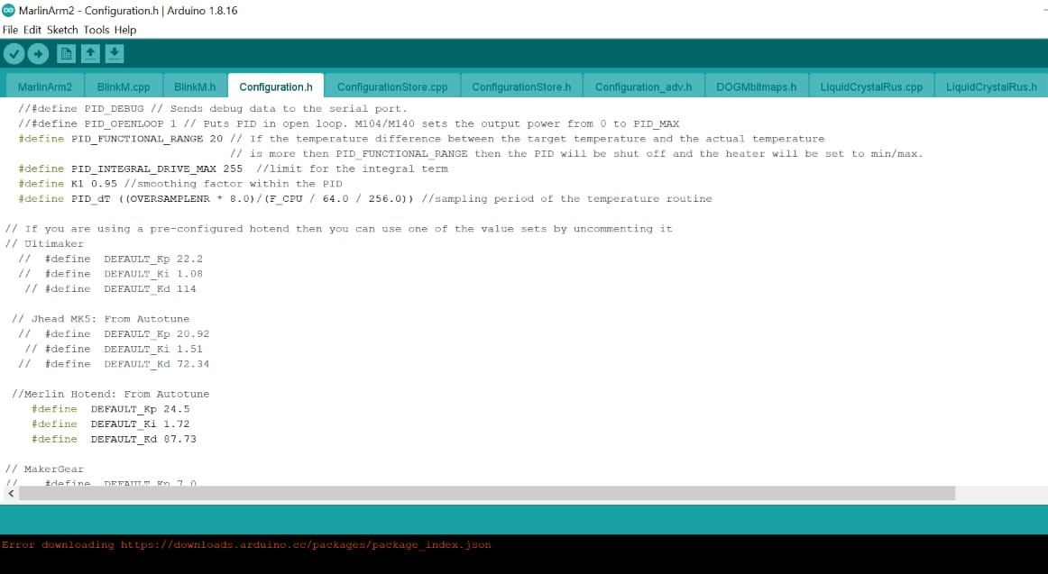
ARDUINO IDE INTERFACE

Slide 15
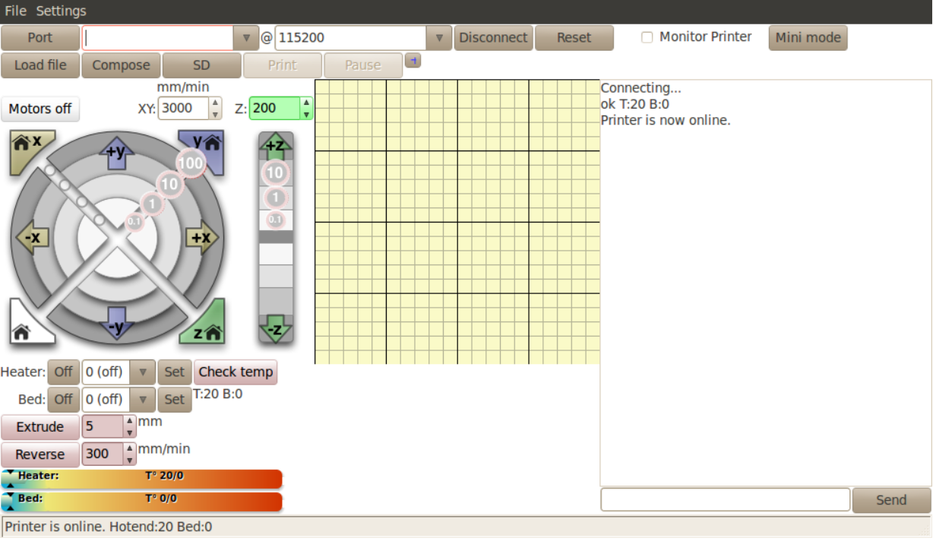
PRONTERFACE INTERFACE

Slide 16
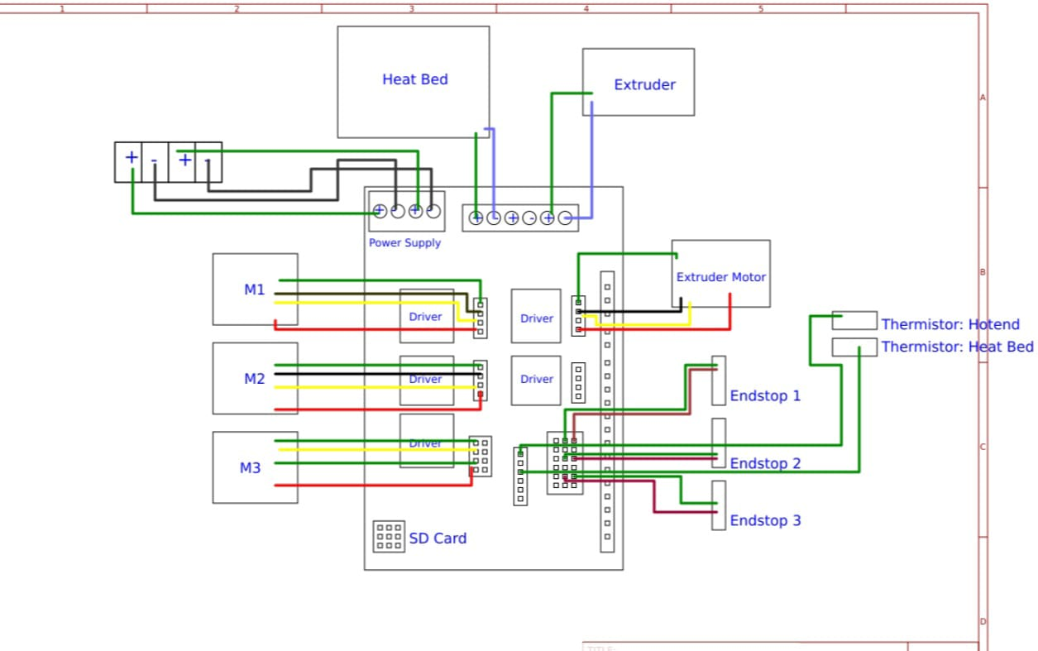
Electrical Circuit Layout

Slide 17
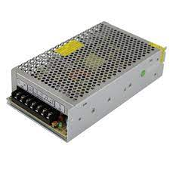
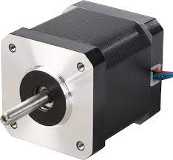
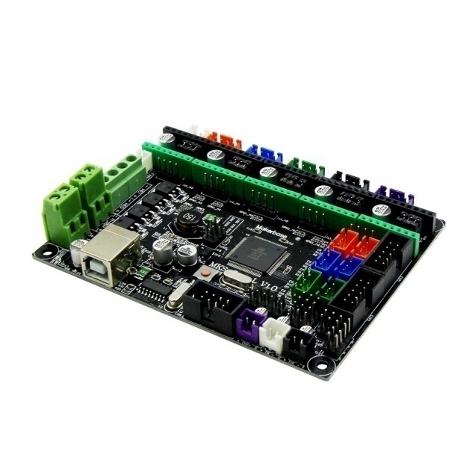
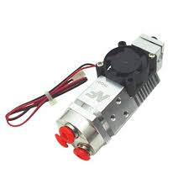
Additional Components
POWER SUPPLY PANNEL
DC STEPPER MOTOR
EXTRUDER
MOTHER BOARD

Slide 18
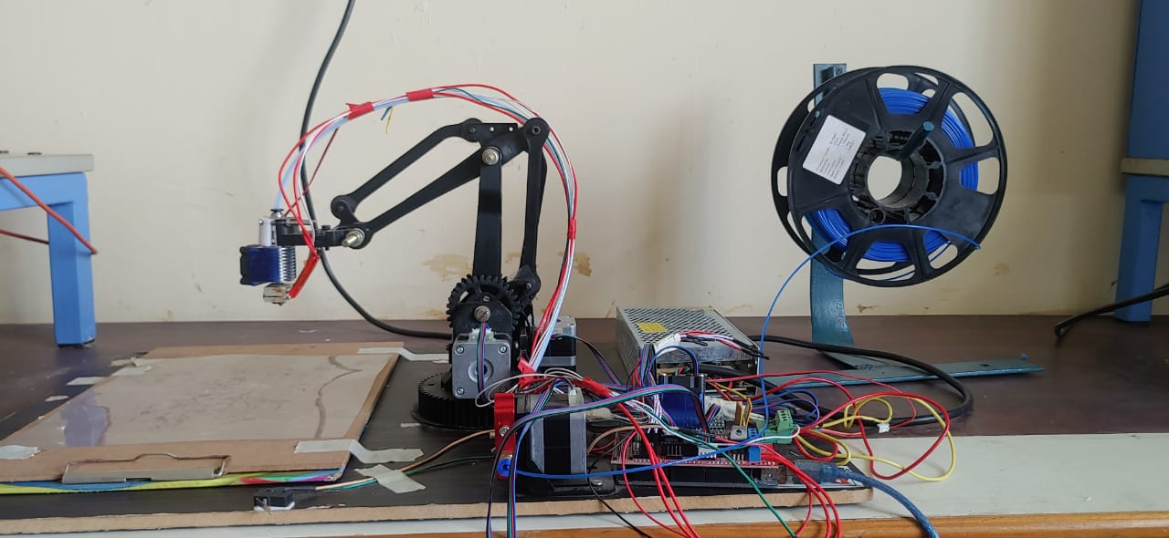
ROBOTIC ARM 3D PRINTER

Slide 19

Video Demonstration

Slide 20
OUTCOME OF THE PROJECT
1. DESIGN AND FABRICATION OF THE ROBOTIC ARM 3D PRINTER WILL BE HELD WITH LESS COST AND WILL WORKING EFFECTIVELY
2. 15-25% OF TIME TO PRINT THE 3D PRODUCT WAS LESS COMPARED TO CARTESIAN PRINTER.
3. REDUCE THE WORK SPACE COMPARE TO THE CARTESIAN PRINTER.
4. THIS TECHNOLOGY IS ECONOMICAL, COMPACT IN SIZE, AND EASY TO PORTABLE.
5. ELIMINATION OF STORAGE DEVICES LIKE SD CARD, ADDITIONAL DRIVES.

Slide 21
REFERENCES
[1] T. Economist. Manufacturing: The third industrial revolution. [Online; accessed 31-March-2018].
[2] G. Jin, W. Li, L. Gao, and K. Popplewell. A hybrid and adaptive tool-path generation approach of rapid prototyping and manufacturing for biomedical models. Computers in Industry, 64 2017.
[3] G. Jin, W. Li, C. Tsai, and L. Wang. Adaptive tool-path generation of rapid prototyping for complex product models. Journal of Manufacturing System 2015.
[4] R. Jones, P. Haufe, E. Sells, P. Iravani, V. Olliver, C. Palmer, and A. Bowyer. Reprap – the replicating rapid prototyper. Robotica,2015.
[5]Mohsen Attaran. The rise of 3-d printing:the advantages of additive manufacturing over traditional manufacturing. Business Horizons,60, 08 2017.
[6] Clothier KurtE and Ying Shan. A geometric approach for robotic arm kinematics with hardware design, electrical design, and implementation. pages 1687–9600, 07 2010.
[7] Fredrick M wema and Esther A kinlabi. Basics of fused deposition modelling (fdm). pages 1–15, 05 2020

Slide 22


